Slide 1

PHASES OF THE MENTOR RELATIONSHIP

Slide 2
Objective
The mentor relationship can significantly enhance development in early adulthood and also in the midcareer stage of the more experienced individual. A conceptual model derived from an intensive biographical interview study of 18 relationships in one corporate setting is presented to highlight the successive phases of this developmental relationship.

Slide 3

PRIMARY TASKS, age groups AND MENTORSHIP
Adult development perspectives suggest that the primary task of early adulthood is one of initiation, and the primary task of middle adulthood is one of reappraisal.
Through a presentation of a conceptual model derived from empirical study, it will be demonstrated that the mentor relationship has great potential to facilitate career advancement and psycho- social development in both early and middle adulthood by providing a vehicle for accomplishing these primary developmental tasks.
Individuals may feel challenged, stimulated, and creative in providing mentoring functions as they become "senior adults" with wisdom to share; alternatively, they may feel rivalrous and threatened by a younger adult's growth and advancement.

Slide 4
RESEARCH METHOD – Young professionals
11 of the 18 relationships were direct reporting relationships; however, 4 of them involved an indirect reporting relationship (separated by two levels of the management hierarchy) in an earlier phase.
Two 2 hour sessions
First Interview - Young manager's career history and to explore relationships with more senior managers that had been important during their life in the organization
"Is there anyone among those that you have mentioned today that you feel has taken a personal interest in you and your development?"
Second Interview - explore one or two relationships with senior managers that had been important in the young manager's career
These significant others then were contacted and invited to participate in a parallel interview sequence

Slide 5
Research METHOD – SENIOR professionals
The study was introduced to the senior managers by reviewing how they had been mentioned by a young manager as someone who had contributed to his or her development.
First Interview – Parallel to the second interview of the young manager
Second Interview - exploring the senior manager's career history
The purpose of this segment was to illuminate how the relationship with the young manager fit into the senior manager's career and, in turn, how the relationship influenced his or her development.

Slide 6
ANALYSIS
A mentor relationship has the potential to enhance career development and psychosocial development of both individuals. Through career functions, including sponsorship, coaching, protection, exposure-and-visibility, and challenging work assignments, a young manager is assisted in learning the ropes of organizational life and in preparing for advancement opportunities. Through psychosocial functions including role modeling, acceptance-and-confirmation, counseling, and friendship, a young manager is supported in developing a sense of competence, confidence, and effectiveness in the managerial role. In providing a range of developmental functions, a senior manager gains recognition and respect from peers and superiors for contributing to the development of young managerial talent, receives confirmation and support from the young manager who seeks counsel, and experiences internal satisfaction in actively enabling a less experienced adult to learn how to navigate successfully in the world of work.

Slide 7
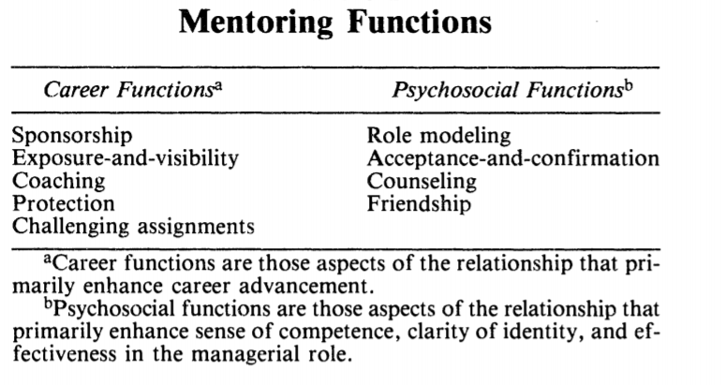

Slide 8

PHASES OF MENTORSHIP
Initiation Phase
Cultivation Phase
Separation Phase
Redefinition Phase

Slide 9
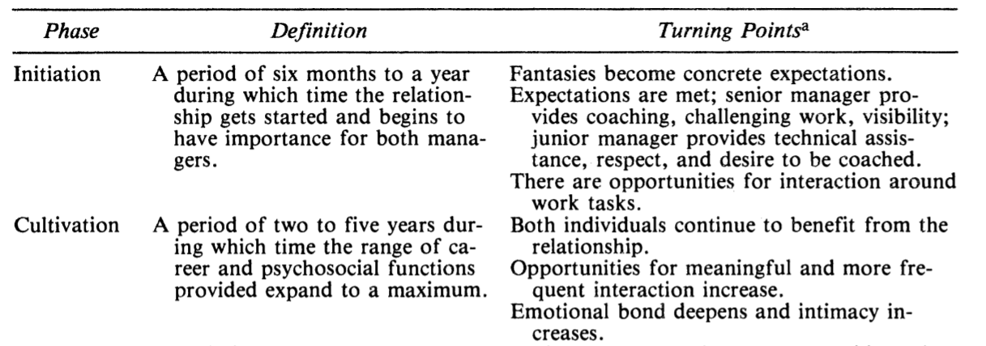

Slide 10
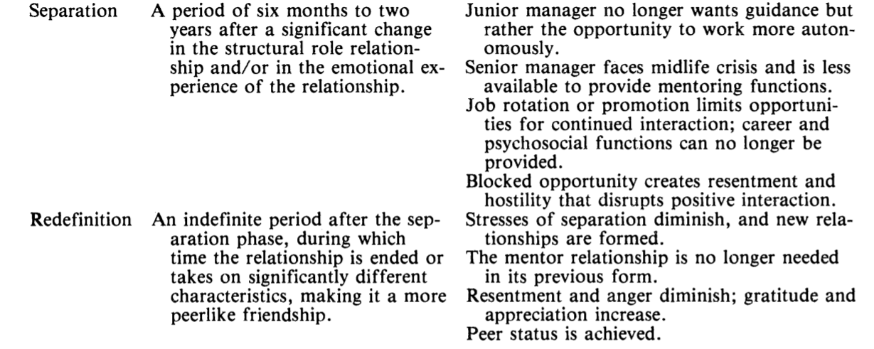

Slide 11
IMPLICATIONS
This dynamic perspective delineates how a mentor relationship can enhance both individuals' development as it unfolds. When primary tasks are complementary, a mentor relationship is likely to reach the cultivation phase and to provide a range of career and psychosocial functions that enable the young adult to meet the challenges of initiation into the world of work, and the senior adult to meet the challenges of reappraisal at midlife
Under certain conditions, a mentor relationship can become destructive for one or both individual. For example, a young manager may feel undermined and held back by his or her mentor, or a senior mentor may feel threatened by the protege's continued success and opportunity for advancement

Slide 13
REFERENCES
Webber, R. Career problems of young managers. California Management Review, 1976, 18(4), 19-33.
Super, E. E. The psychology of careers. New York: Harper and Row, 1957
KATHY E. KRAM,”Phases of the Mentor Relationship” Academy of Management Journal 1983, Vol. 26, No. 4, 608-625
Sheehy, G. The mentor connection. New York Magazine, April 5, 1976, 30-39.
Shapiro, E., Haseltine, F., & Rowe, M. Moving up: Role models, mentors, and the "patron system." Sloan Management Review, 1978, 19(3), 51-58.
Phillips, L. L. Mentors and proteges: A study of the career development of women managers and executives in business and industry. Doctoral dissertation, UCLA, 1977, University Microfilms Inter- national No. 78-6517.

Slide 14
Neugarten, B. Middle age and aging: A reader in social psychology. Chicago: University of Chicago Press, 1968.
Levinson, D. J., Darrow, C. N., Klein, E. B., Levinson, M. A., & McKee, B. Seasons of a man's life. New York: Knopf, 1978.
Hall, D. T. Careers in organizations. Glenview, Ill.: Scott, Foresman, 1976
Gould, R. Transformations: Growth and change in adult life. New York: Simon & Schuster, 1978.
Gould, R. The phases of adult life: A study in developmental psychology. The American Journal of Psychiatry, 1972, 129, 521-531.
Dalton, G., Thompson, P., & Price, R. The four stages of professional careers-A new look at per- formance by professionals. Organizational Dynamics, 1977, 6(1), 19-42.
Google Images

